Slide 1
Things To Know
Town Hall
April 8th 2015

Slide 2
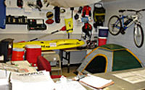
You can rent things from mwr
The Port Hueneme Outdoor Recreation department of MWR has athletic, recreational and camping gear available for rent.
(805) 982-4282
They rent: trailers, tents, other camping stuff, bicycles, kayaks, boogie boards, surfboards, snowboards, 6’ tables, party chairs, 10x10 canopy, and
other yard party necessities.

Slide 3
The ticket office sells more than tickets to amusement parks
They sell discounted tickets for:
Airport Shuttle Service
Movie Tickets
Gift Certificates
Coupon Books
And Amusement Parks
Hueneme: Bldg 1167 (805) 982-4284
Mugu: Bldg 16 (805) 989-7628

Slide 4
Armed Forces vacation club
Armed Forces Vacation Club is a “space available” program offering military and other DoD affiliated personnel the opportunity to enjoy vacations at popular destinations around the world for only $349 per unit/week. Accommodations only, meals and transportation not included. www.afvclub.com
They send a lot of emails all the time. So be ready for that when you sign up.

Slide 5
Swimming pool!
Mugu Pool: Bldg 217 (805) 989-7788
DoD: $2 per person
Morning:
Mon-Fri: 0600-0830
Lunch:
Mon and Wed: 1100-1300
Tue, Thur, and Fri: 1130-1300

Slide 6
Unsure about where a building is?
NAVAIR has an online map website. It’s super easy to use!
https://cl-pwd-gis.navair.navy.mil/cl/default.aspx
Click NAVAIR Viewer
Enter the building number
Note: This only works with NAVAIR locations (China Lake and Point Mugu). It does not include Hueneme.

Slide 7
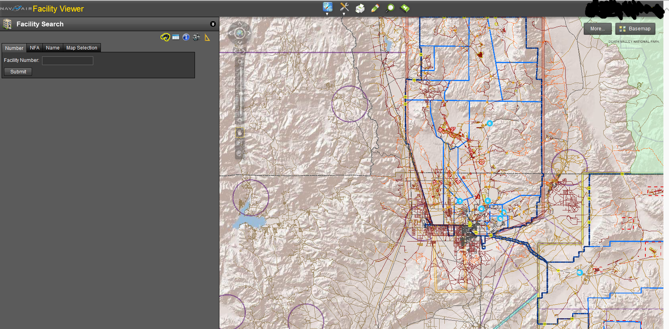
This is how easy it is

Slide 8
Non emergency help
Non Emergency Dispatch: (805) 982-4591 DSN 551-4591
This goes to Hueneme, but tell them what you need and they will transfer you.
Non Emergency Fire Department: (805) 989-7034 DSN 351-7034 or (805) 989-7303 DSN 351-7303
This is where you call to get hot work permits, heat producing device permits, and all other questions can be answered. It is connected to an answering machine and they are prompt in responding to messages.

Slide 9
NON Emergency help at Home
VC Sheriff Dispatch: 805-654-9511
Port Hueneme Police Dept: 805-986-6530
Oxnard Police Department: 805-385-7600
VC Sheriff's Office: 805-654-2890 (Patrol) 805-654-2380 (Info)
Camarillo Police Department: 805-388-5100
Moorpark Police: 805-532-2700
East County Sheriff Station: 805-494-8260
Thousand Oaks Police Department 805-494-8200
Ventura Police Department: 805-339-4400 805-650-8010

Slide 10
NON Emergency help at Home
Ventura Fire: 805-389-9710
Individual Fire Station 805-371-1111 (when prompted enter station number for example: Ext 54 is Camarillo, 50 is Camarillo Airport, 52 is Mission Oaks, etc.)
CHP Dispatch: 805-477-4174
CHP Moorpark: 805-553-0800
CHP Ventura: 805-477-4100
http://readyventuracounty.org Emergency preparedness (highly recommended, most everything can be found here)

Slide 11
Emergency help
Dial 911
You will be directed to emergency dispatch. In order to get help quickly, you need to provide them with your location ( Naval Base Ventura County Point Mugu) and the building number. Cross streets are also very helpful, so be mindful of where you are.
If you call from your cell phone, you will go to Ventura County dispatch. You must provide them with your location (Naval Base Ventura County Point Mugu) and they will transfer you to our dispatch.

Slide 12
Emergency at home
Dial 911
http://VCEmergency.com (web page only updated when there is any emergency in Ventura County, will give info etc
Notification service:
VC Alert Ready Ventura County:
http://www.readyventuracounty.org/index.php?option=com_content&view=article&id=57&Itemid=11
Ventura County has implemented a state-of-the-art emergency notification system to alert residents about emergencies and other important community news. The emergency notification system enables officials to provide essential information quickly when there is a threat to the health or safety of residents.

Slide 13
Alert/Notification Systems
VC Alert Ready Ventura County:
http://www.readyventuracounty.org/index.php?option=com_content&view=article&id=57&Itemid=11
Ventura County has implemented a state-of-the-art emergency notification system to alert residents about emergencies and other important community news. The emergency notification system enables officials to provide essential information quickly when there is a threat to the health or safety of residents.
http://www.nixle.com/
https://local.nixle.com/register/
https://local.nixle.com/ventura-county-sheriffs-office/
Nixle keeps you up-to-date with relevant information from your local public safety departments & schools
Ventura County Sheriff Office posts alerts via Nixle (as do other local law enforcement agencies and the CHP). Very useful in case of fires/closures/evacuations, esp if you have kids in local schools and you want to be notified of emergencies.

Slide 14
Need help with a phone number?
Point Mugu has an operator! (805) 989-1110 DSN 351-1110
China Lake also has one: (760) 939-9011 DSN 437-9011

Slide 15
Problem with gate guards?
A CAL Supervisor: (805) 276-0399
You can let them know what your problem/concern is, and they will let you know why it may have happened and try to keep it from happening in the future.

Slide 16
safety
If you have a heater in your office, it should have an automatic shut off when it tips over.
If you have a microwave, toaster oven, coffee pot, or other heat producing device; you need to call the previous phone number for the fire department and have them give you a permit. Its not difficult to get one, and it prevents you from getting in trouble if anything goes wrong.
Do not stack anything on top of bookshelves
You cannot have anything blocking access to a walkway, an emergency exit, electrical panel, or CRAC unit.

Slide 17
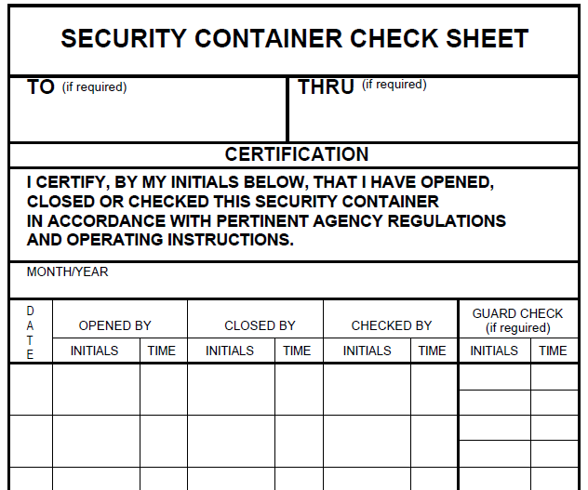
Security
If you have a safe in your office/cube, you are responsible for it and the contents. This includes marking the SF 702 (that should be on it) at the end of every working day ensuring that it is locked.
Even if you do not open it, you must check it EVERY working day.
Don’t want a safe anymore? Contact Carolanne Perez (she is currently on leave. But will be back next month)

Slide 18
Home use Microsoft Office and visio for $10 each
http://www.microsofthup.com/hupus//home.aspx?programCode=67F2F2491D&culture=en-US&country_id=US&WT.mc_id=MA_Email_EmailACoworkerReturn
Your organization's Microsoft HUP Program Code is: 67F2F2491D
You go and register with your .mil email and then when they send you a conformation email, you forward it to the email address associated with the computer you want to have office on.

Slide 19
Navy e-book site – free!
To sign up, go to NKO. The MyNAVAIR link does not work, try this link https://wwwa.nko.navy.mil/group/nkomain
Select REFERENCE from the yellow bar near the top of the page
Select E-library - Audio & EBooks from the list on the left of the page
Select download from the Overdrive - Audiobooks, Ebooks & More
Select Account, then fill in the new users section
Go to your home computer, iPhone, or other device. The link for Navy Overdrive is
http://navy.lib.overdrive.com/9987A6F6-F9C8-41A5-857E-A6FD4EEF689A/10/50/en/Default.htm

Slide 20
More free e-books
http://techbus.safaribooksonline.com/?uicode=dodnavy
They even have an app for your smart device!

Slide 21
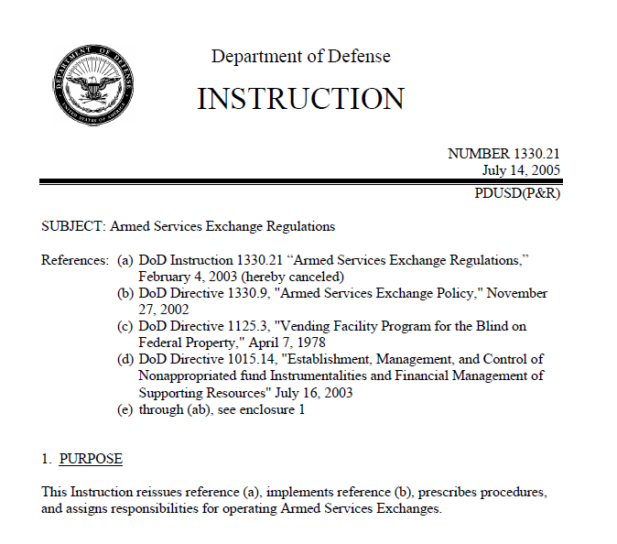
Buying food and drink from nex

Slide 22
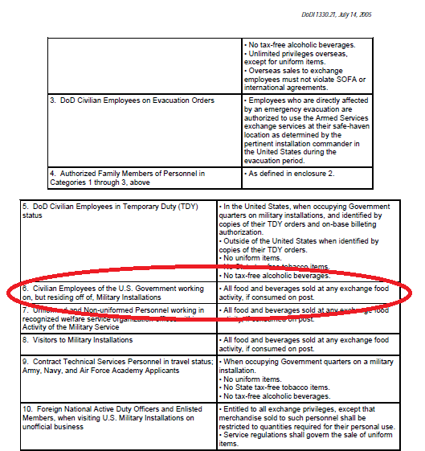
DoDI 1330.21, E6.1.2., category 6
All food and beverages sold at any exchange food activity, if consumed on post.
This does not mean you can do your grocery shopping at the NEX. But you can grab some lunch, or a snack and a drink.

Slide 23
Buying food and drink from the nex
Be mindful that people in uniforms get front of the line privileges during certain hours.
The person at the register will always ask for ID. So present your CAC to them.
You cannot buy anything besides food and drink (non alcohol).

Slide 24
Special thanks to:
Aviram Carmi for all the helpful emergency information!!!!

